Slide 1
H.264 Entropy coding

Slide 2
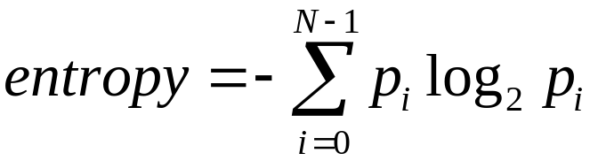
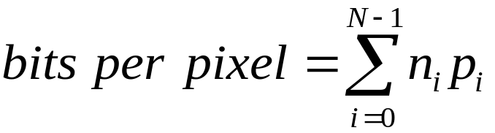
무손실 부호화(lossless coding)
 확률을 기반으로 한 정보 이론(information theory)에서 출발
 엔트로피(entropy) : 영상의 평균 정보량을 나타내는 지표
p_{i} : i 값을 가지는 화소의 발생 확률
 평균 화소 당 비트 수
n_{i} : 그레이 값 i를 부호화하는데
필요한 비트 수
p_{i} : i 값을 가지는 화소의 발생 확률
 0 ≤ 엔트로피 ≤ 평균 화소 당 비트 수

Slide 3
허프만 부호화(Huffman coding)
 빈번하게 발생하는 자료의 표현에 적은 수의 비트를 할당하고,
드물게 발생하는 자료의 경우는 보다 많은 비트들을 할당
symbol | 확률
A1 | 0.1
A2 | 0.4
A3 | 0.06
A4 | 0.1
A5 | 0.04
A6 | 0.3
 | symbol | 1 단계 | 2 단계 | 3 단계 | 4 단계
A2 | 0.4(1) | 0.4(1) | 0.4(1) | 0.4(1) | 0.6(0)
A6 | 0.3(00) | 0.3(00) | 0.3(00) | 0.3(00) | 0.4(1)
A1 | 0.1(011) | 0.1(011) | 0.2(010) | 0.3(01)
A4 | 0.1(0100) | 0.1(0100) | 0.1(011)
A3 | 0.06(01010) | 0.1(0101)
A5 | 0.04(01011)
Entropy : 2.14 bit
고정 비트 할당 : 3 bit
허프만부호화 : 2.2 bit

Slide 4
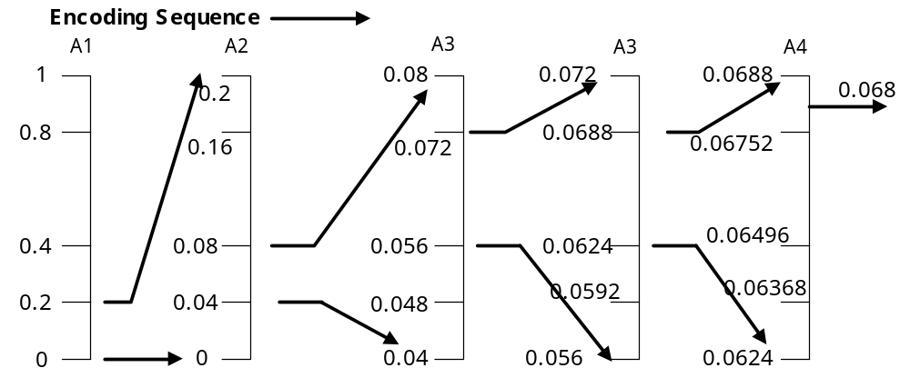
산술 부호화(Arithmatic coding)
 허프만 부호화는 코드 워드 생성과정이 복잡
→ 산술 부호화가 허프만 부호화의 대안이 될 수 있다.
 화소 값들이 가지고 있는 확률을 부호화하는 방법
 A1-A2-A3-A3-A4를 부호화하고자 한다면
Symbol | 확률 | 구간
A1 | 0.2 | [0.0, 0.2]
A2 | 0.2 | [0.2, 0.4]
A3 | 0.4 | [0.4, 0.8]
A4 | 0.2 | [0.8, 1.0]

Slide 5
연속 길이 부호화(run length coding)
 연속 길이(run-length) : 같은 그레이 값을 가지고 연속적으로 나오는
화소의 개수
 연속 길이를 부호화하는 방법
이진 영상의 예
그레이 영상의 예
0 | 0 | 0 | 0 | 0 | 0 | 0 | 0
0 | 1 | 1 | 1 | 0 | 0 | 0 | 0
1 | 1 | 0 | 0 | 1 | 1 | 1 | 1
10 | 10 | 10 | 10 | 10 | 10 | 10 | 10
10 | 10 | 20 | 20 | 20 | 20 | 20 | 20
20 | 20 | 20 | 20 | 10 | 10 | 10 | 10
첫 번째 라인 : 8
두 번째 라인 : 1, 3, 4
세 번째 라인 : 0, 2, 2, 4
첫 번째 라인 : (10, 8)
두 번째 라인 : (10, 2) (20, 6)
세 번째 라인 : (20, 4) (10, 4)

Slide 6
DC 계수의 엔트로피 코딩
DC_{i-1} : 40, DC_{i} : 43
DC_{i} - DC_{i-1} = 43 – 40 = 3
Size(bit 수) | Amplitude
0 | 0
1 | -1, 1
2 | -3, -2, 2, 3
3 | -7∼-4, 4∼7
4 | -15∼-8, 8∼15
5 | -31∼-16, 16∼31
6 | -63∼-32, 32∼63
7 | -127∼-64, 64∼127
8 | -255∼-128, 128∼255
Size = 2
Amplitude = 11
If) size ‘2’에 해당하는 허프만
부호를 ‘011’로 가정하면,
최종적인 부호값은
011(size) : 11(amplitude)
= 01111

Slide 7
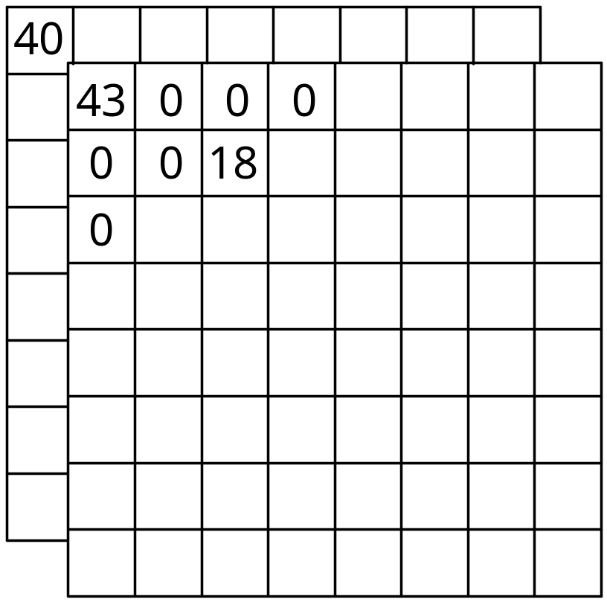
AC 계수의 엔트로피 코딩
여섯 개의 0과 18이라는 값을 차례로 갖는다고 가정
Run : 6
18 의 size : 5
18의 amplitude : 10010
(6/5, 10010)
(6/5)의 허프만 코딩값이 1101이라고 가정
최종적인 부호화 값은 110110010

Slide 8
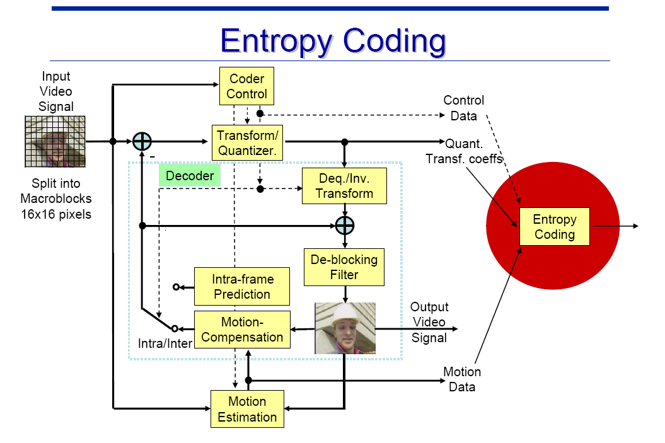
Introduction

Slide 9
Introduction
Three types of entropy coding in H.264
  Context-based Adaptive Binary Arithmetic Coding (CABAC) => Part of main profile
  Context-based Adaptive Variable Length Coding (CAVLC) => Part of baseline profile
  Exponential Golomb Coding => Part of baseline profile
CAVLC is designed to use of several characteristics of quantized 4x4 blocks

Slide 10
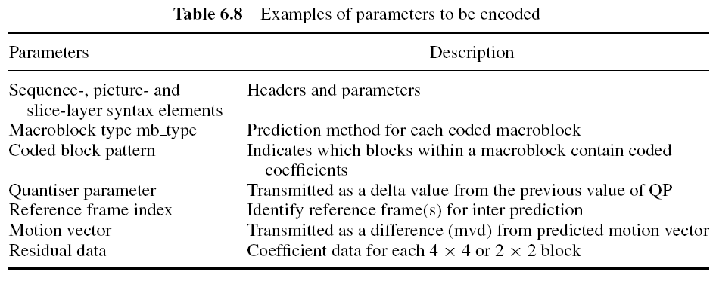
Baseline Entropy Coding
Fix-length or EG code
CAVLC(Context-Adaptive VLC)

Slide 11
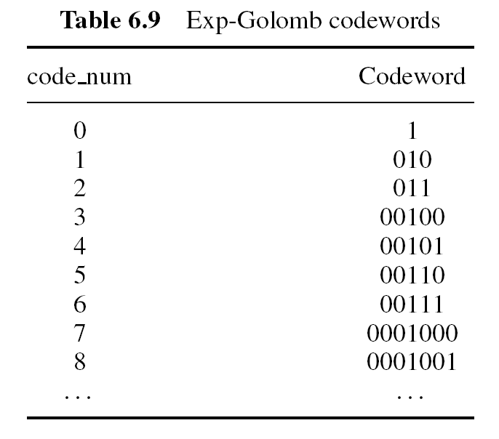
Exponential Golomb Entropy Coding 1/2
Regular construction
Frequent information
[M zeros][1][INFO]
Decoding
  Read in M leading zeros followed by 1
  Read M-bit INFO field
  Code_num=2^{M} + INFO – 1 ex) 2² + 10(2) – 1 = 5

Slide 12
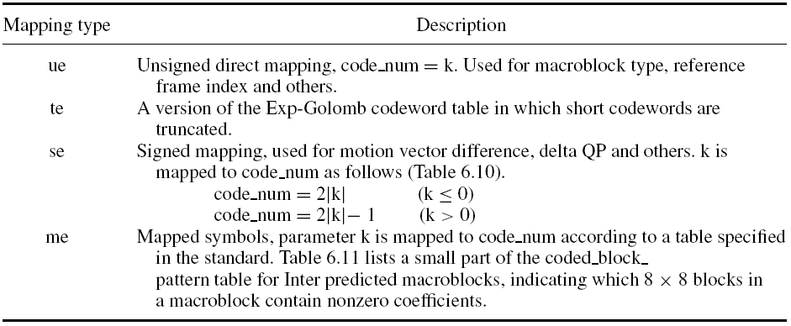
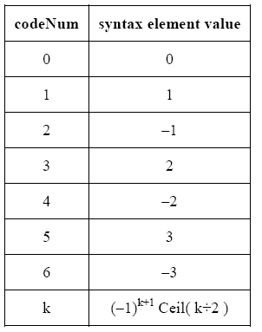
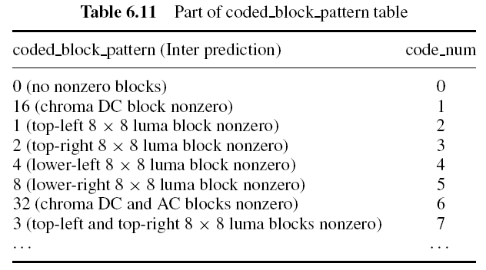
Exponential Golomb Entropy Coding 2/2
Assignment of syntax element to codeNum
for signed Exp-Golomb coded syntax elements se(v)

Slide 13
Concept of CAVLC 1/2
After prediction, transformation and quantization, blocks are typically sparse (containing mostly zeros).
  CAVLC uses run-level coding to compactly represent strings of zeros.
The highest of non-zero coefficients after the zig-zag scan are often sequences of +/-1.
  CAVLC signals the number of high-frequency +/-1 coefficients (“Trailing 1s” or “T1s”) in a compact way.

Slide 14
Concept of CAVLC 2/2
The number of non-zero coefficients in neighboring blocks is correlated.
  The number of coefficients is encoded using a look-up table.
  The choice of look-up table depends on the number of non-zero coefficients in neighboring blocks.
The level (magnitude) of non-zero coefficients tends to be higher at the start of the reordered array (near DC coefficient) and lower toward the higher frequencies.
  CAVLC use this by adapting the choice of VLC look-up table for the “level” parameter depending on recently-coded level magnitudes.

Slide 15
Coding flow of CAVLC
NumTrail
Total coefficients & Trailing Ones
Sign Trail
Sign of trailing Ones
Levels
Level ( sign and magnitude )
TotalsZeros
Total number of zeros
Runs
Run of zeros and run_before

Slide 16
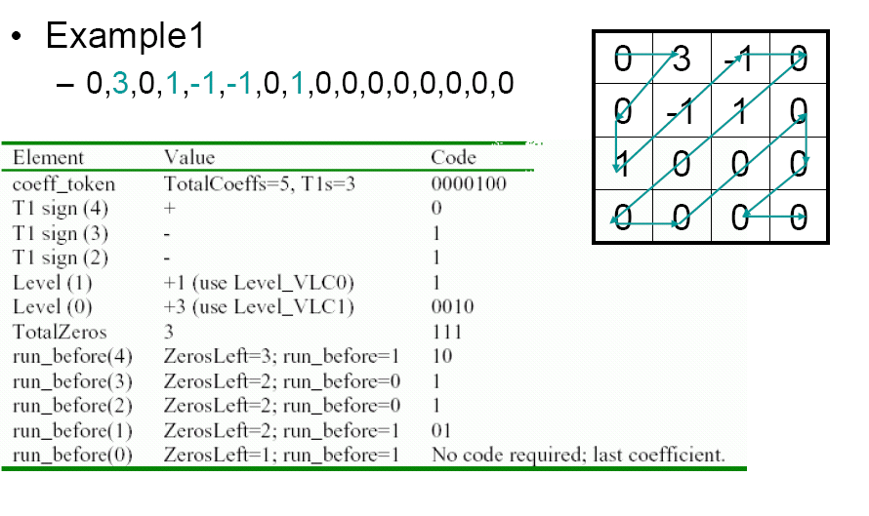
CAVLC Example (Encoding)

Slide 17
Encode the number of coefficients and trailing ones (coeff_token)
The total number of non-zero coefficients (TotalCoeffs) and the number of trailing +/-1 values (T1s) encoded
  TotalCoeffs can be anything from 0 to 16.
  T1 can be anything form 0 to 3
    If there are more than 3 trailing +/-1s, only the last 3 are treated as “special case” and any others are coded as normal coefficients.

Slide 18
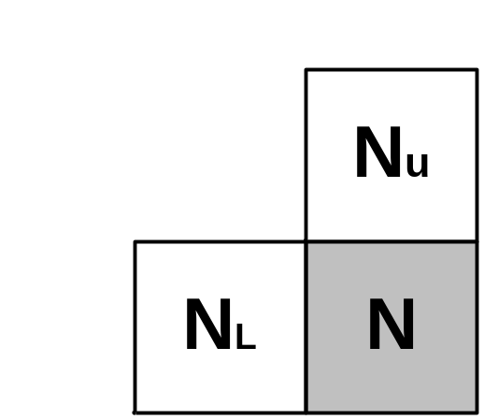
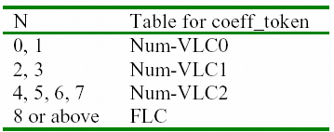
Choice method of look-up table
If blocks Nu and NL are available
N = ( Nu + NL ) / 2
If only blocks Nu is available, N = Nu
If only blocks NL is available, N = NL

Slide 19
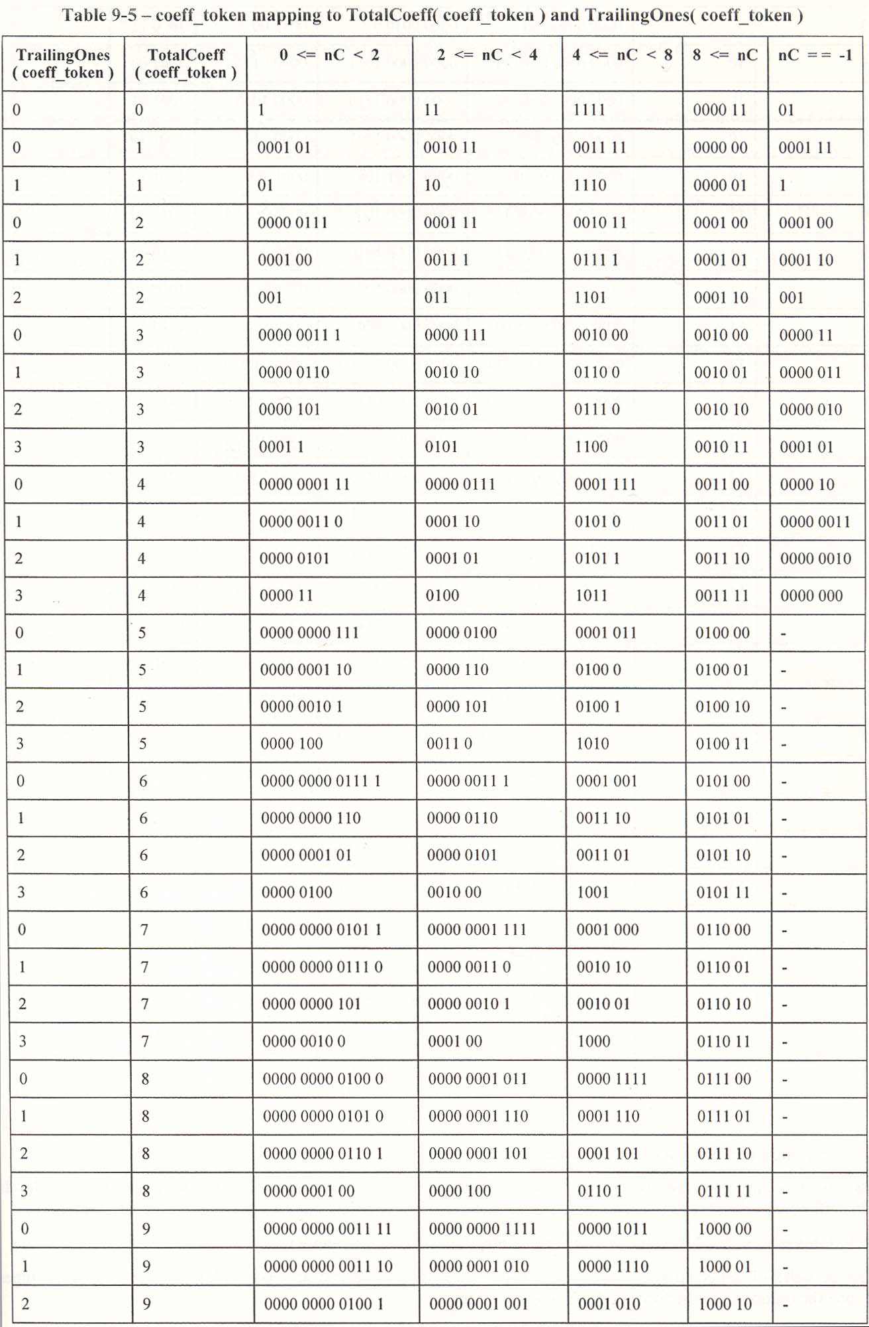
TotalCoeff and TrailingOnes table

Slide 20
Context adaptive for coeff_token
There are 4 choice of look-up table to use for encoding coeff_token, described as Num-VLC0, Num-VLC1, Num-VLC2, and Num-FLC (3 variable-length code table and a fixed-length code).
  Num-VLC0 is biased towards small numbers of coefficients.
  Num-VLC1 is biased towards medium numbers of coefficients.
  Num-VLC2 is biased towards higher numbers of coefficients.
  FLC assigns a fixed 6-bit code to every value of TotalCoeff.
The choice of table depend on the number of non-zero coefficients in upper and left-hand previously coded blocks Nu and NL. (Context adaptive)

Slide 21
CAVLC Example (Encoding)
Input :
The choice of VLC table to encode each level adapts depending on the magnitude of each successive coded level.

Slide 22
Encode the number of coeﬃcients and T1
Encode the sign of each T1
  For each T1 (trailing +/-1) signaled by coeff_token, a single bit encodes the sign (0 = +, 1 = -).
  These are encoded in reverse order
    Starting with the highest-frequency T1.
Encode the levels of the remaining non-zero coefficients
  The level (sign and magnitude) of each remaining non-zero coefficient in the block is endoded in reverse order.
    Starting with the highest frequency and working back toward the DC coefficient.

Slide 23
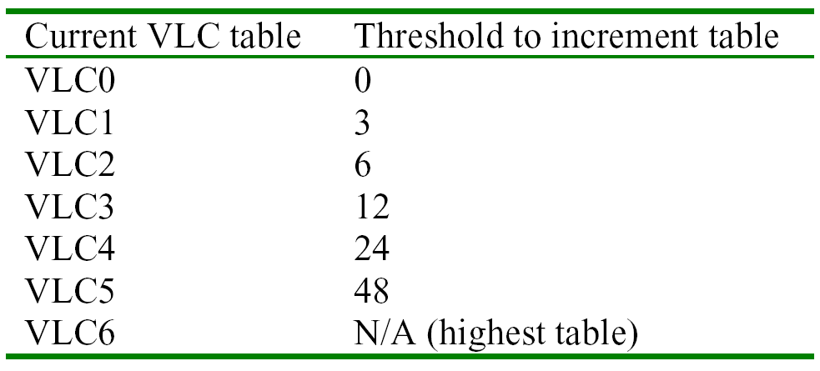
Choice method of level table
Initialize the table to Level-VLC0.
  Unless there are more than 10 non-zero coefficient and less than 3 trailing ones, in which case start with Level-VLC1.
Encode the highest-frequency non-zero coefficient.
If the magnitude of this coefficient is larger than a pre-defined threshold, move up to next VLC table.

Slide 24
Context adaptive for level
The choice of VLC table to encode each level adapts depending on the magnitude of each successive coded level.
There are 7 VLC tables.
  Level-VLC0 is biased towards lower magnitudes.
  Level-VLC1 is biased towards slightly higher magnitudes and so on.

Slide 25
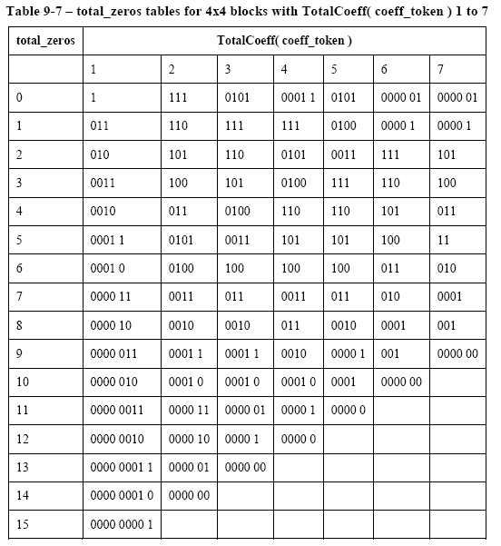
Encoding TotalZeros
Encode the total number of zeros before the last coefficient.
  TotalZeros is the sum of all zeros preceding the highest non-zero coefficient in the reordered array.
  This is coded with a VLC. (TotoaZeros, TotalCoeff)

Slide 26
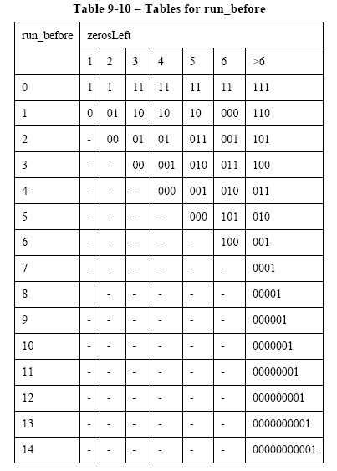
Encoding (ZeroLeft, run_before)
Encode each run of zeros.
  The number of zeros preceding each non-zero coefficient (run_before) is encoded in reverse order.
  This is coded with a VLC. (ZeroLeft, run_before)

Slide 27
CAVLC Example (Encoding)

Slide 28
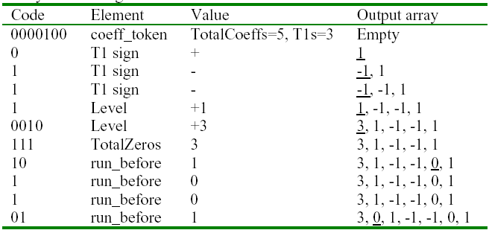
CAVLC Example (Decoding)
The Transmitted bitstream : 0000 1000 1110 0101 1110 1101
The final output array : 0, 3, 0, 1, -1, -1, 0, 1

Slide 29
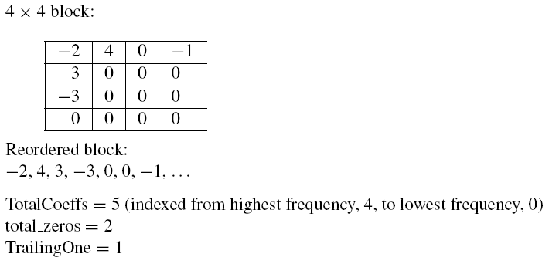
CAVLC Example (Encoding)
Example(4x4 block)

Slide 30
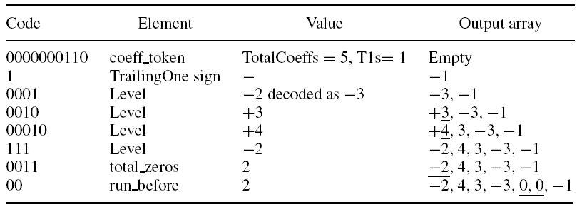
CAVLC Example (Decoding)
Example(Decoding)

Slide 31
JM 8.4
main() // in lencod.c
{
for( img->number = 0; img->number < no_frames)
{ // in lencod.c
// encode one I- or P-frame
encode_one_frame() // in lencod.c
→ frame_picture(frame_pic) // in image.c
→ code_a_picture(frame) // in image.c
// in slice.c
→ encode_one_slice (SliceGroup, pic)
}
}

Slide 32
encode_one_slice()
encode_one_slice(SliceGroupID, Picture)
{
// 슬라이스 초기화 및 헤더 생성(25bit)
// CAVLC 초기화
while( end_of_slice == FALSE )
// 매크로블록 초기화
start_macroblock();
encode_one_macroblock();
write_one_macroblock();
}

Slide 33
JM 8.4
encode_one_macroblock () // in encode_one_slice()
  LumaResidualcoding()
    dct_luma() //Transfrom & Quantization
write_one_macroblock(1) // in encode_one_slice()
  writeMotionInfo2NAL()
  writeCBPandLumaCoeff()
    writeCoeff4x4_CAVLC()

Slide 34
JM 8.4
Declaration
Macroblock *currMB = &img->mb_data[img->current_mb_nr];
SyntaxElement *currSE = &img->MB_SyntaxElements[currMB->currSEnr];
int k,level,run,vlcnum;
int numcoeff, lastcoeff, numtrailingones;
int numones, totzeros, zerosleft, numcoef;
int numcoeff_vlc; // look-up table choice
int incVlc[] = {0,3,6,12,24,48,32768}; // maximum vlc = 6
int* pLevel = NULL;
int* pRun = NULL;

Slide 35
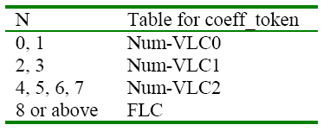
JM 8.4
Choice of look-up table for coeff_token
nnz = predict_nnz(subblock_x, subblock_y);
if (nnz < 2) numcoeff_vlc = 0;
else if (nnz < 4) numcoeff_vlc = 1;
else if (nnz < 8) numcoeff_vlc = 2;
else numcoeff_vlc = 3;

Slide 36
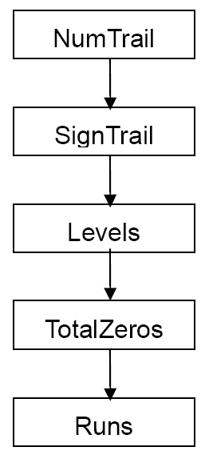
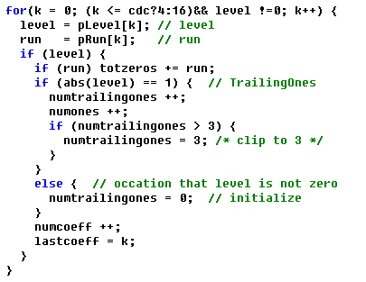
JM 8.4
writeSyntaxElement_NumCoeffTrailingOnes(currSE, dataPart);
Notes:
currSE->type = dptype;
currSE->value1 = numcoeff;
currSE->value2 = numtrailingones;
currSE->len = numcoeff_vlc; /* use len to pass vlcnum */

Slide 37
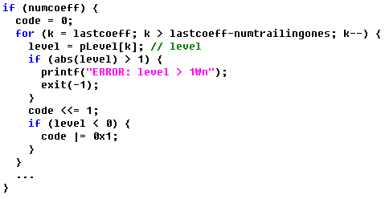
JM 8.4
writeSyntaxElement_VLC (currSE, dataPart);
Notes:
currSE->type = dptype;
currSE->value2 = numtrailingones;
currSE->value1 = code;

Slide 38
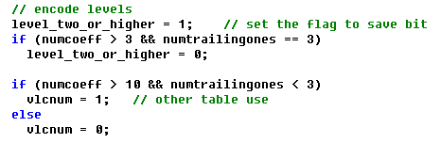
JM 8.4
Levels 1
±2 maps to ±1, ±3 map to ±2
Shorter VLCs are used.
Notes:
suffixLength 0으로 초기화(nonzero가 10개보다 많고 trailing ones가 3개보다 작으면 1로)
가장 높은 주파수의 0이 아닌 계수를 인코딩
계수의 크기가 미리 정의된 임계값보다 크면 suffixlength를 증가(이 계수가 인코딩될 첫번째 계수이고 suffixlength가 0으로 초기화되었다면 suffixlength를 2로 한다)

Slide 39
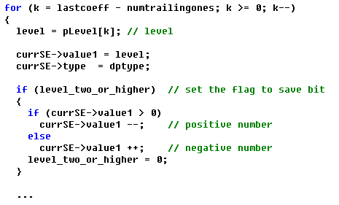
JM 8.4
Levels 2
Notes:
suffixLength 0으로 초기화(nonzero가 10개보다 많고 trailing ones가 3개보다 작으면 1로)
가장 높은 주파수의 0이 아닌 계수를 인코딩
계수의 크기가 미리 정의된 임계값보다 크면 suffixlength를 증가(이 계수가 인코딩될 첫번째 계수이고 suffixlength가 0으로 초기화되었다면 suffixlength를 2로 한다)

Slide 40
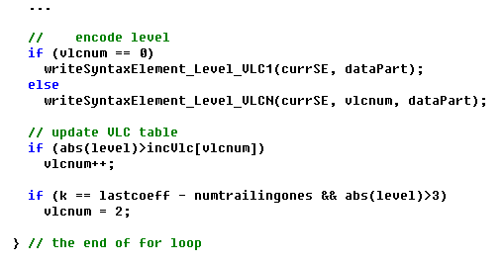
JM 8.4
Levels 3
writeSyntaxElement_Level_VLC1(currSE, dataPart);
Notes:
suffixLength 0으로 초기화(nonzero가 10개보다 많고 trailing ones가 3개보다 작으면 1로)
가장 높은 주파수의 0이 아닌 계수를 인코딩
계수의 크기가 미리 정의된 임계값보다 크면 suffixlength를 증가(이 계수가 인코딩될 첫번째 계수이고 suffixlength가 0으로 초기화되었다면 suffixlength를 2로 한다)

Slide 41
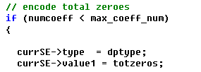
JM 8.4
writeSyntaxElement_TotalZeros(currSE, dataPart);

Slide 42
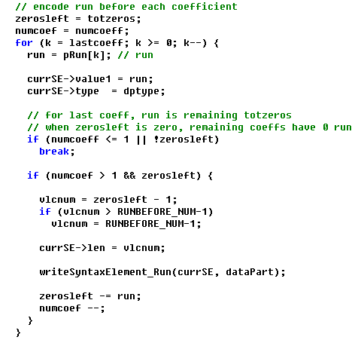
JM 8.4
writeSyntaxElement_Run()

